Slide 1
Agenda of Session
Installation GitLab Runner
Register GitLab Runner
Run GitLab Runner
Push code on GitLab
Deploy code on Heroku via GitLab
Mapping Salesforce sObject with Heroku
Dyno Configure on Heroku
Heroku releases and rollback deployment via Heroku CLI

Slide 2
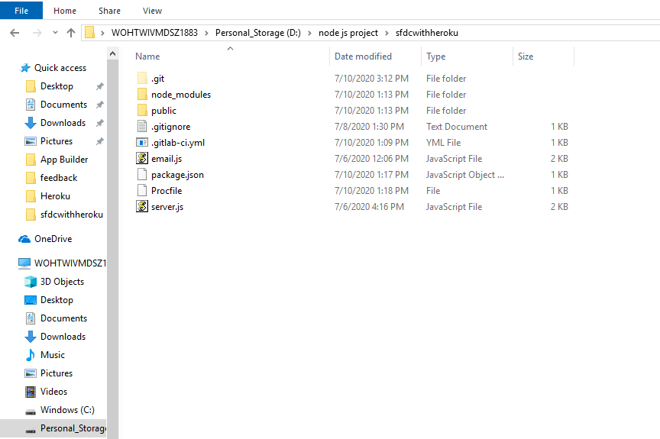

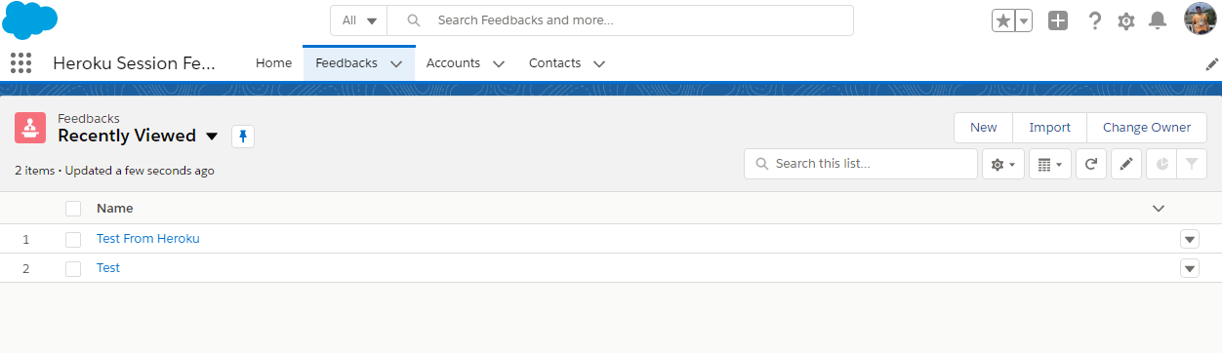

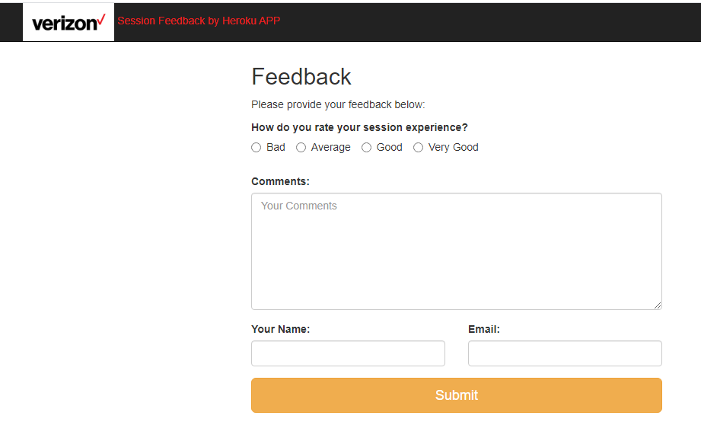

App Flow Diagram

Slide 3
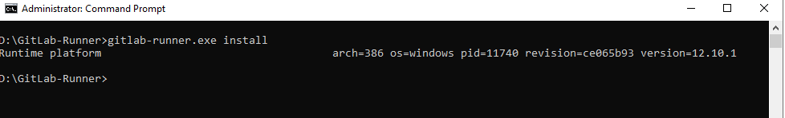
Installation GitLab Runner
Step 1. Create a folder somewhere in your system ex. D:\GitLab-Runner
https://gitlab-runner-downloads.s3.amazonaws.com/latest/binaries/gitlab-runner-windows-386.exe
Step 2. Download the binary for x86 or amd64 and put it into the folder you created. Rename the binary to gitlab-runner.exe.
Step 3. Run CMD as Administrator
Step 4.

Slide 4
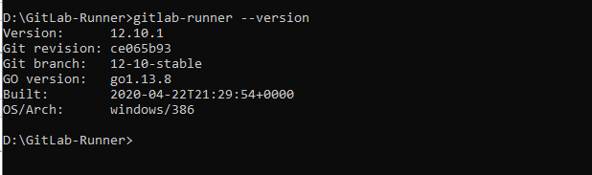
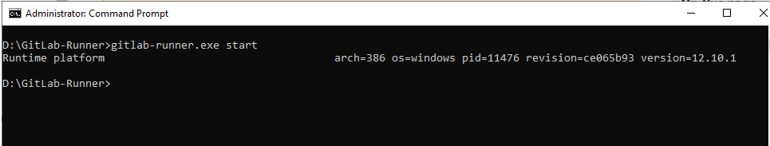
Step 5.
Step 6.

Slide 5
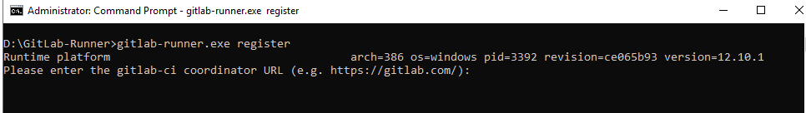
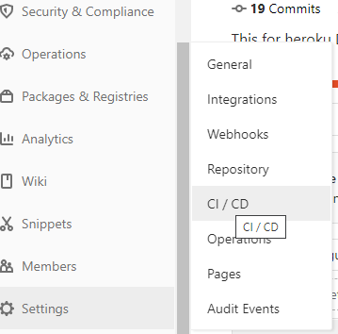
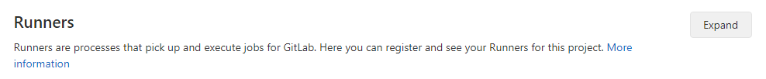
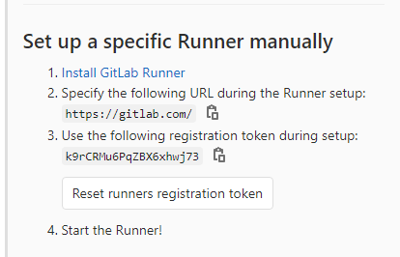
Register GitLab Runner
Step 1.

Slide 6

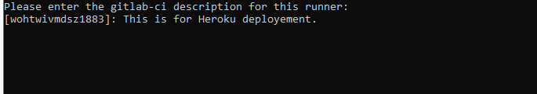

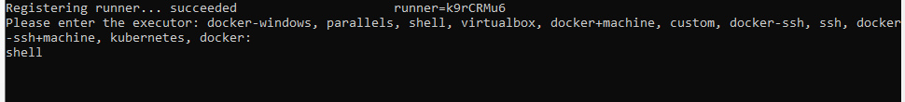
Step 2.
Step 3.
Step 4.
Step 5.

Slide 7
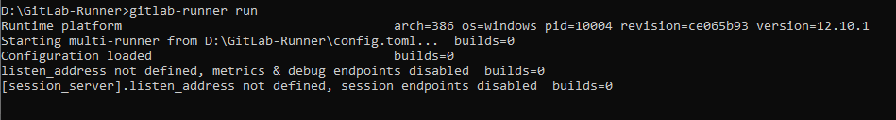
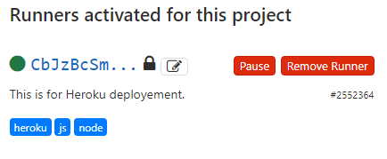
Step 6.
Step 7.

Slide 8
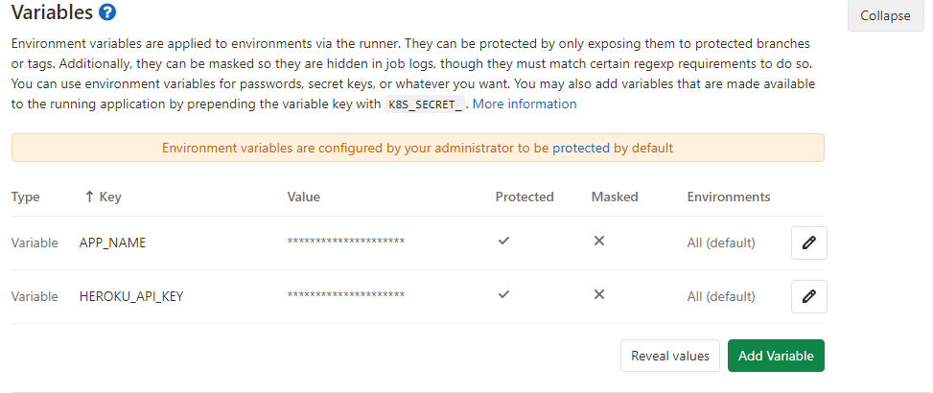
Deploy code on Heroku via GitLab

Slide 9
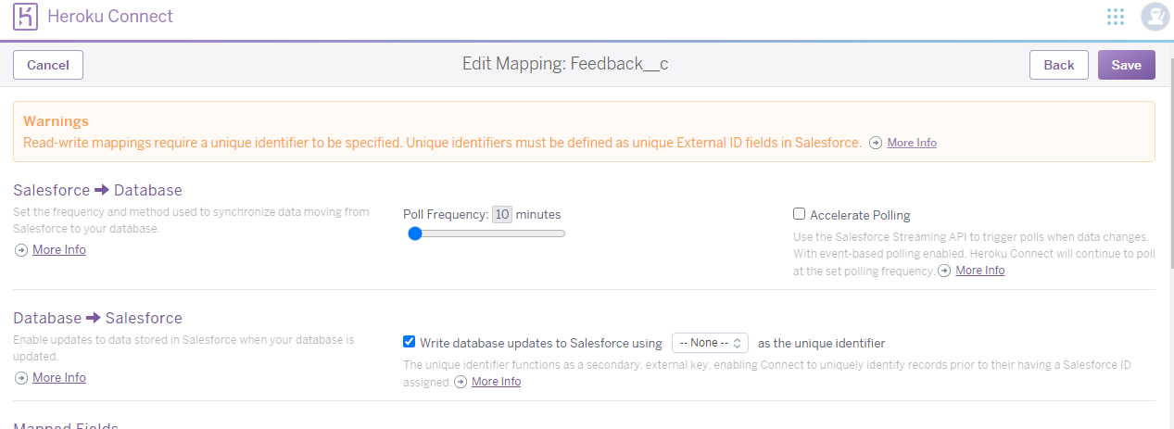
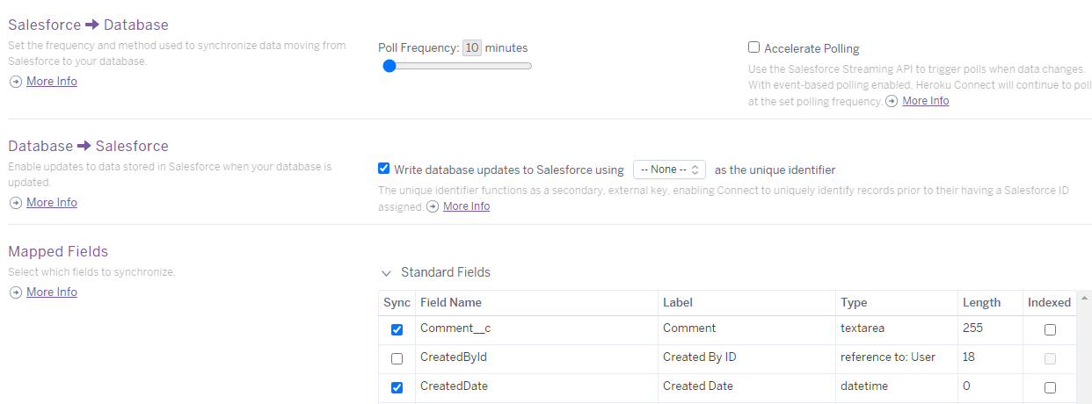
Mapping Salesforce sObject with Heroku

Slide 10
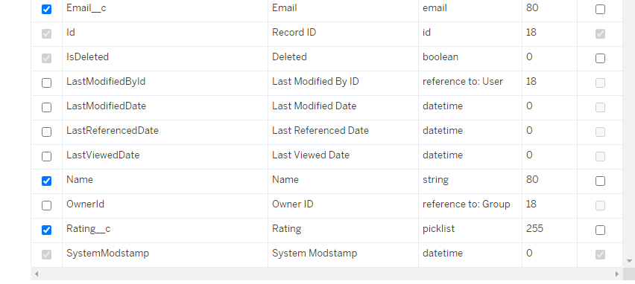

Slide 11
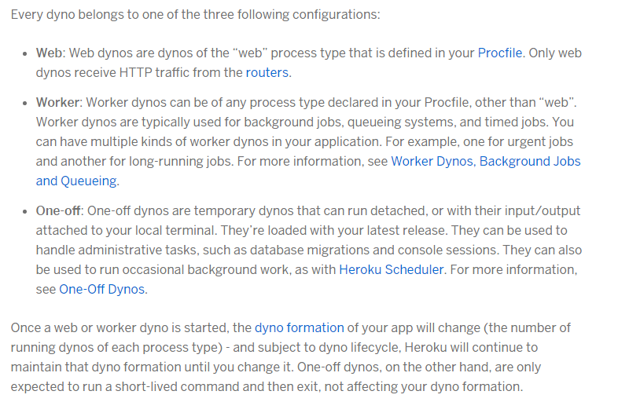
Dyno Configure on Heroku

Slide 12
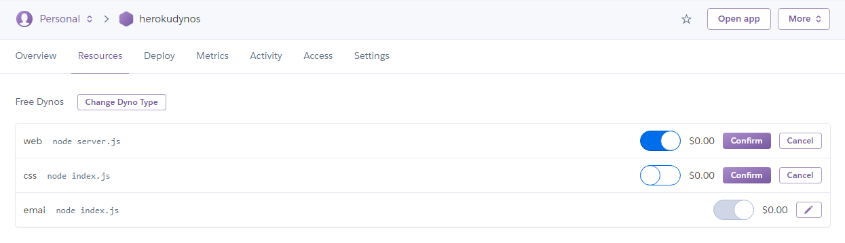

Slide 13
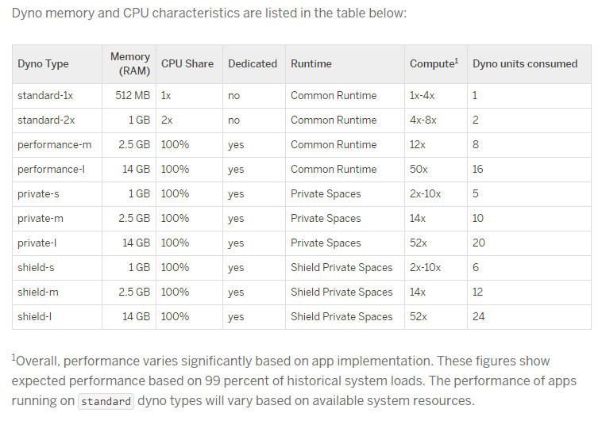

Slide 14
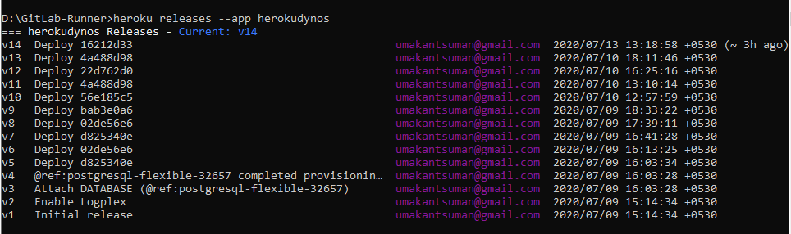
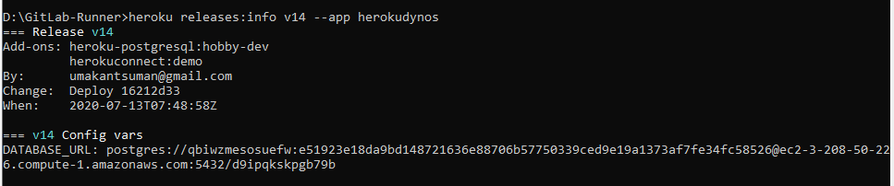
Releases and rollback deployment via Heroku CLI

Slide 15


Slide 16


